Slide 1
Presenting
MEDTRUST HOSPITAL MANAGEMENT SYSTEM
Your Trustable Healthcare System
Your Trust Our Innovation

Slide 2

Meet our team ‘INNOVATIVE PROGRAMMERS’
Soumyajit Sadhukhan
Sangita Ghosal
Abhijit Kundu

Slide 3
What is this Software?
Our software is a Hospital Management System, developed to enhance the operational efficiency of hospitals and clinics.
Key Highlights:
Digital Patient Records: Stores and manages patient details efficiently.
Appointment Scheduling: Simplifies the process of scheduling online and offline appointments.
Prescription Management: Generates and maintains prescriptions for patients.
Purpose:
To streamline hospital workflows, reduce administrative workload,
and improve patient care through technology.

Slide 4
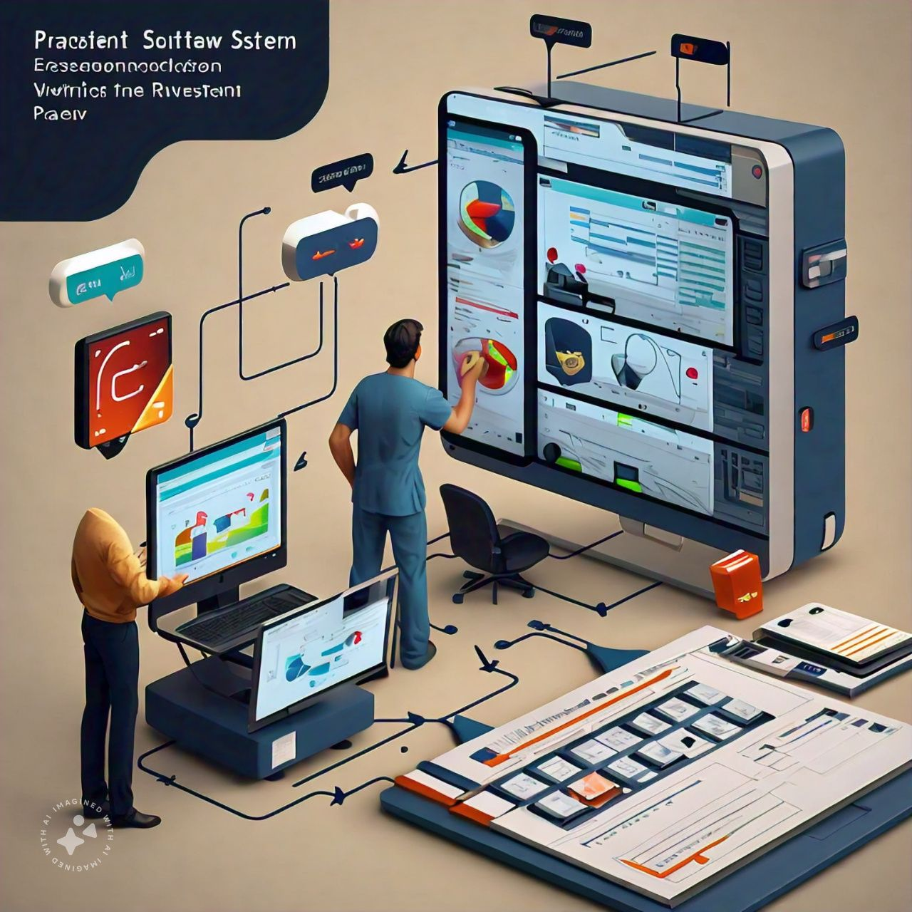

:SYSTEM WORKFLOW :
ADMIN VALIDATION & DATA INPUT
APPOINTMENT SCHEDULING
RECORD MANAGEMENT WITH MYSQL
PRESCRIPTION GENERATION

Slide 5

KEY FUNCTIONALITIES OF OUR SYSTEM
FEATURES
CENTRALISED PATIENT RECORDS
APPOINTMENT SCHEDULING
PRESCRIPTION GENERATION
INTEGRATION WITH MySQL
BENEFITS
ENHANCED EFFICIENCY
IMPROVED PATIENT EXPERIENCE
User friendly ui

Slide 6
WHY THIS SOFTWARE…
Data Security and Retrieving Ability
Easy to Use and User Friendly UI
Cost Efficiency
Digital Record Keeping
Sustainability
Time Efficiency

Slide 7
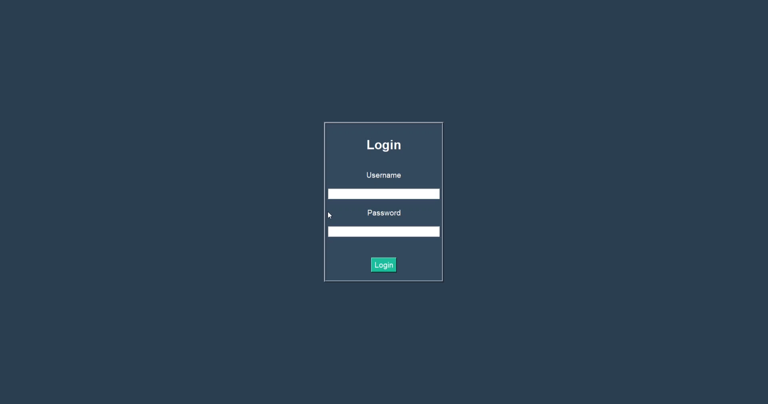
DEMO VIDEO

Slide 8

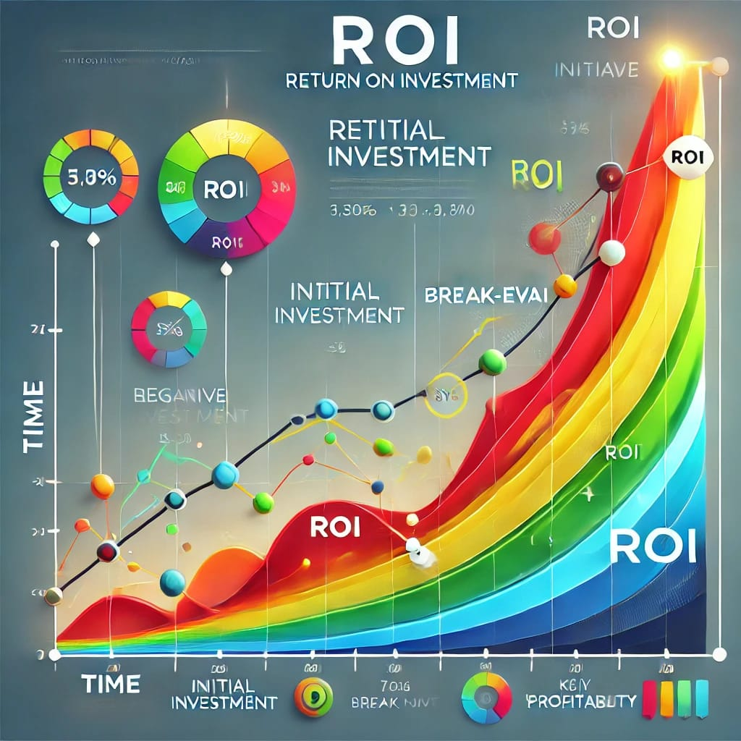

RELATION OF COST & ROI

Slide 9

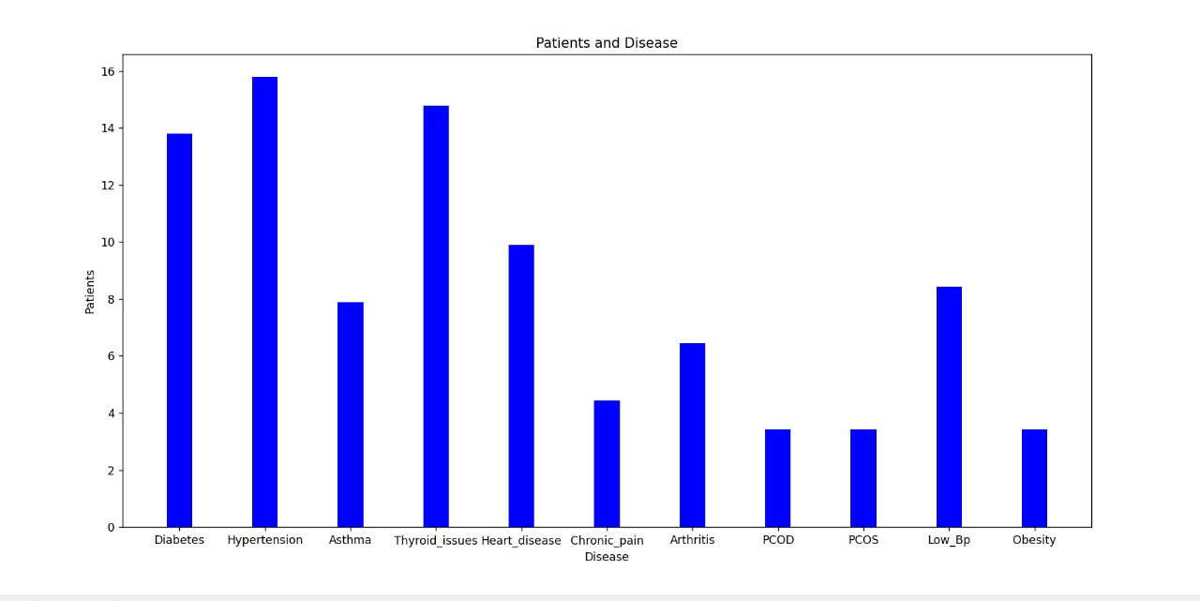
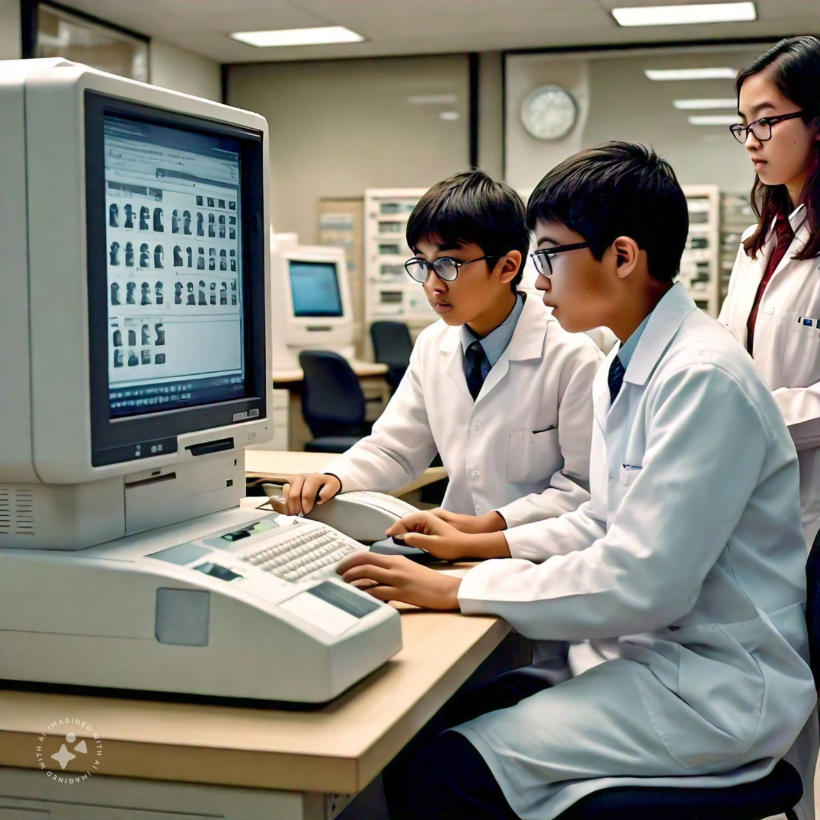

DATA OF
AVERAGE DISEASE RATE OF
MEDTRUST
HOSPITAL

Slide 10


Technical architectures
Programming language for the backend : PYTHON
GUI development :
Tkinter
Database management:
MySQL

Slide 11


THANK YOU EVERYONE

